Slide 1
C#.net MVC Bootcamp Cebu University of Cebu - Banilad
Sonny Recio | Fullstack Web Developer (MS Technologies)

Slide 2

Meet Sonny Recio | ‏@yellowflashdev
Fullstack Web Developer
Specializes in MS technologies such as ASP.net MVC, ASP.net core, Winforms, WPF for 4-5 years
Well-versed in using front-end technologies such as AngularJS, Angular 4, vanilla javascript
Practitioner of TDD
Other specialties
IT consultant
Blogger / Article Writer
Productivity hacker

Slide 3
Course Topics
Introduction to ASP.NET MVC for beginners
01 | Introduction to ASP.net MVC (overview, features, scopes)
02 | Get comfortable with the basics of MVC
03 | Communicating with the database using Entity Framework 6
04 | Where to go from here

Slide 4
Setting Expectations
Target Audience
.NET Developer who is new to web development
Web developer who is new to .NET
Web Forms developer who wants to learn ASP.NET MVC
Suggested Prerequisites
Visual Studio 2017 Community Edition
SQL Server Express
SQL Server Management Studio

Slide 5
01 | Introduction to ASP.net MVC

Slide 6
Module Overview
ASP.NET overview
What is MVC?
Features of MVC 5
What is MVC pattern and why it’s better than webforms
Prerequisites

Slide 7
ASP.net overview

Slide 8
ASP.NET overview
ASP.NET is a server-side web application framework designed for web development to produce dynamic web pages. It was developed by Microsoft to allow programmers to build dynamic web sites, web applications and web services.
ASP.NET is built on top of .NET framework, which provides an application program interface (API) for software programmers. The .NET development tools can be used to create applications for both the Windows operating system and the Web.

Slide 9
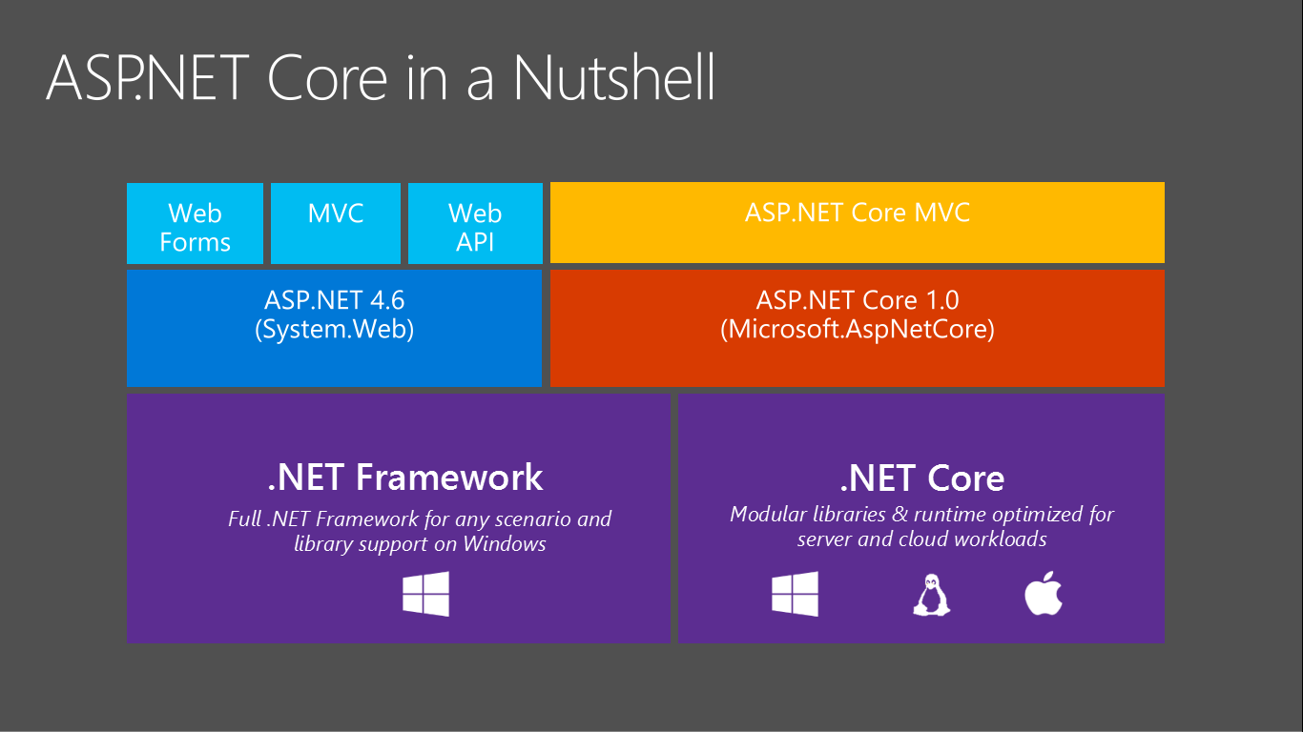

Slide 10
What is MVC

Slide 11
What is MVC?
Model–view–controller (MVC) is a software architectural pattern for implementing user interfaces on computers. It divides a given application into three interconnected parts.
Model represents your data structure. An object which is a collection of key-value pairs. Serves as an intermediary between view and controller. Persists data to the view.
View represents User Interface or the final output with models modelled by controller or so.
Controller connects the model and view.

Slide 12
Models, Views, and Controllers
What does MVC look like?
Request
Controller
Controller
Retrieves Model
“Does Stuff”

Model

Response
View
View
Visually represents
the model

Notes:
Students will learn more about Entity Framework and data access in Module 2.
Students will learn more about the ASP.NET Routing Engine in Module 7.
20486A
01: Exploring ASP.NET MVC 4

Slide 13
Seems complicated. What’s the point?
Every web application needs some structure
MVC helps you stay organized, start to finish
Often end up with less code, not more
Smoother learning curve as your project grows

Slide 14
Features of MVC 5

Slide 15
Features of MVC 5
OWIN and katana as middleware
Better Identity and Membership manager
Bundled with Bootstrap 3
Web API 2
Entity Framework 6

Slide 16
Why MVC pattern is better than webforms

Slide 17
Why MVC pattern is better than webforms
Better separation of concerns
Modularized (e.g. separating logic of HR module and Payroll Module efficiently)
Efficient url mapping through routing
Unit Testable (Unit Tests, TDD)
Total control over html and urls

Slide 18
Prerequisites

Slide 19
Prerequisites
Visual Studio (at least Community Edition 2015 and above)
SQL Server Express
SQL Server Management Studio

Slide 20
02 | Getting comfortable with the basics of MVC

Slide 21
Module Overview (Delving with the fun parts!)
Creating a new MVC project using Visual Studio
Deep dive with Model, View, Controller
Routes
Designing your views using bootstrap

Slide 22
Creating a new MVC project using Visual Studio

Slide 23
Creating an MVC app

Slide 24
Exercise # 1
Create a new MVC project using Visual Studio
Select MVC as template
Run the MVC project you’ve just made
Play around with MVC as you wish

Slide 25
Deep dive with Model, View, Controller

Slide 26
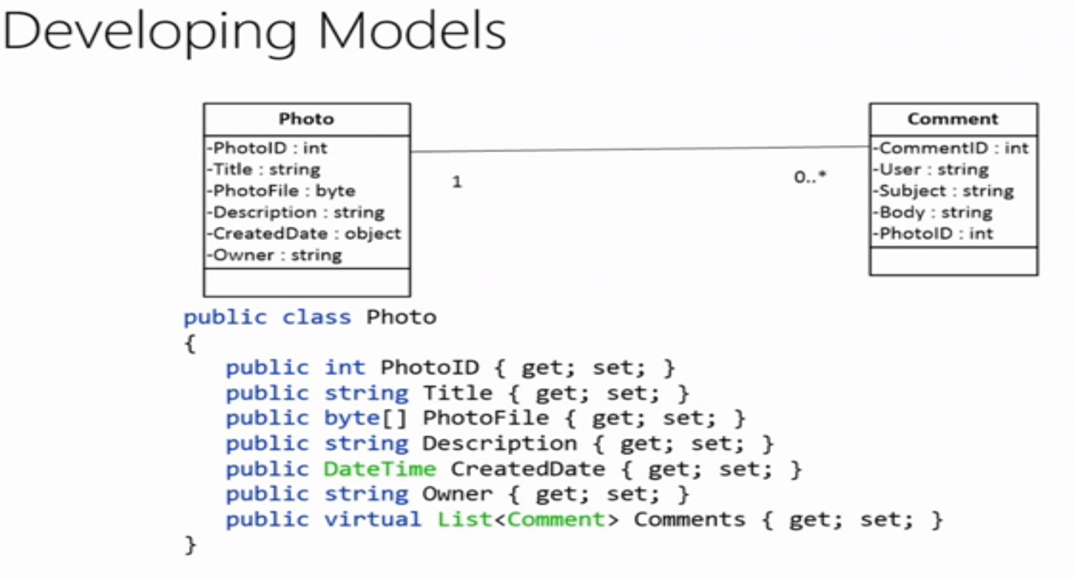

Slide 27
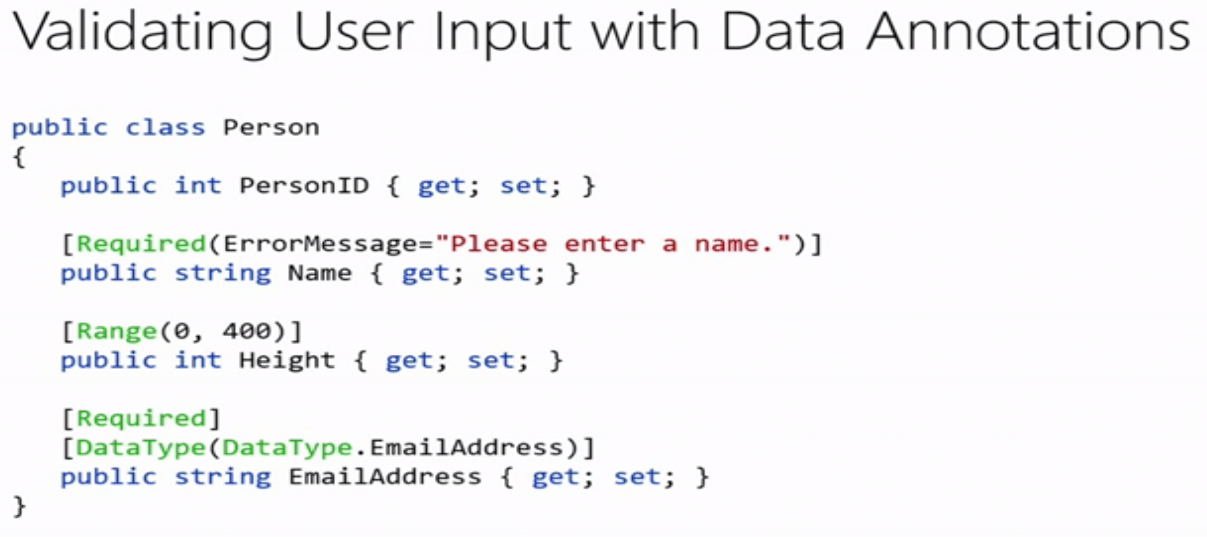

Slide 28
Models, Views, Controllers (continued)
In model, you can use C# classes(POCO) to contain and persist the data to the view
View has lots of engines, thus they were sometimes called as “View Engines”
Controllers have the ability to control which views and/or models to throw at the user

Slide 29
More on Models
Most models come in a form of just a plain C# objects
You can add data annotations to your C# objects as models to let the user know they weren’t violating anything in the input form (such as incorrect email address and incorrect contact #). You can then add ModelState.IsValid to know if the rulings based on data annotations were followed.
Using ViewBag and ViewData is a bad practice as they’re dynamic and makes it hard to test (unless if you’re unit testing MVC itself)

Slide 30
Playing with models

Slide 31
More on Controllers
The methods inside a controller is called an Action. This action can either return a rendered view with model, a json object, or a single primitive value.
With controllers, you can determine which models and views to return in an action depending on user actions.
You can also redirect a user to another page using RedirectToAction()

Slide 32
Playing with controllers

Slide 33
More on Views (some quirks and tips)
_Layout.html serves as the master layout of MVC application and renders the views that was thrown by the controller in @RenderBody()
You can reuse a reusable html layouts using the syntax @Html.Partial(“your reusable view here”). Make sure it sits on Shared folder to be reused. You can also achieve the same result as @Html.Action() but it was using a controller and an action.
You use @Html.BeginForm() to submit a data to the server. Typically used in forms and input fields

Slide 34
Playing with Views

Slide 35
Exercise # 2
Creating a new Controller with Views
Play around with ViewBag, ViewData, or C# model and display the results in your views. For added challenge, try to create a form and display the contents in another page.
Create a partial page and try to reuse it in various pages

Slide 36
Some tips
You can use scaffolding to make the process of creating Views and Models easier

Slide 37
Routes

Slide 38
What’s in ASP.net MVC routing
ASP.NET routing enables you to use URLs that do not have to map to specific files in a Web site. Because the URL does not have to map to a file, you can use URLs that are descriptive of the user's action and therefore are more easily understood by users.
In an ASP.NET application that does not use routing, an incoming request for a URL typically maps to a physical file that handles the request, such as an .aspx file.

Slide 39
Designing your views using bootstrap

Slide 40
About bootstrap
Bootstrap is the most popular HTML, CSS, and JavaScript framework for developing responsive, mobile-first web sites.
It’s one of the existing front-end frameworks for designing web applications
It allows you to design html pages through using css classes located in bootstrap.css
It also allows you to

Slide 41
More on bootstrap
Grid system makes it easy for you to separate and display layouts based on the screen resolution (mobile display, desktop display, etc.)

Slide 42
Designing razor views using bootstrap

Slide 43
Exercise # 3
Design the page as you see fit using bootstrap. Follow the guidelines of the documentation to use and play around with it.

Slide 44
03 | Communicating with the database using Entity Framework 6

Slide 45
Module Overview
Overview of EF6
Approaches for using Entity Framework
Setting up and installing EF6 in the project
Inserting records in DB
Modifying records in DB
Deleting records in DB
Wrapping it up

Slide 46
Overview of EF6
Entity framework is an Object/Relational Mapping (O/RM) framework. It is an enhancement to ADO.NET that gives developers an automated mechanism for accessing & storing the data in the database.

Slide 47
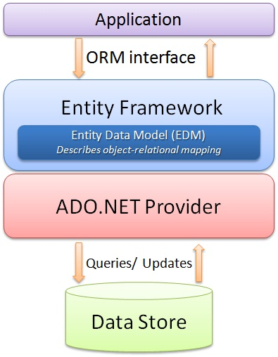
Complex View

Slide 48
Simplified View
LINQ to Entities
Convert to query and execute
Map results to Entities

Slide 49
What is ORM exactly?
Object-relational mapping (ORM, O/RM, and O/R mapping tool) in computer science is a programming technique for converting data between incompatible type systems using object-oriented programming languages. This creates, in effect, a "virtual object database" that can be used from within the programming language.

Slide 50
Approaches for using Entity Framework 6
Code-first approach
Database-first approach

Slide 51
Approaches (cont.)
Code-first uses pure code to create database tables first than creating it in db.
Database-first communicates with the db first and generate POCO objects from it for you to query.

Slide 52
Installing Entity Framework in the project

Slide 53
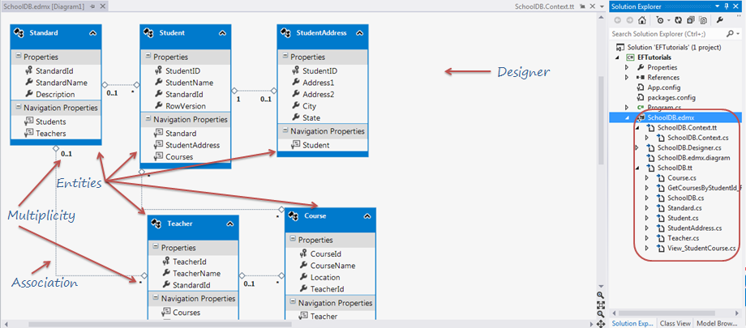
If you have many tables with relationships

Slide 54
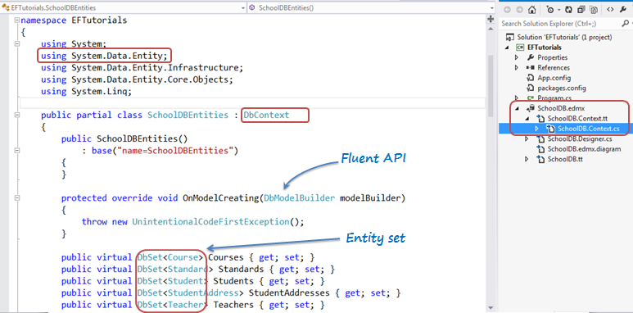
Some important points
DbContext is an important part of Entity Framework. It is a bridge between your domain or entity classes and the database.

Slide 55
Exercise # 4
Create a new database. Name it IntroMvcDb
Create a table in the database. Name it ‘Employee’. It should have the following fields: Id, Fname, Mname, Lname, Position
Create new Entity Data Model. Select “EF Designer from database”. Name it anything you like.
Find Employee.cs from your Entity Data Model you just created

Slide 56
Add/Edit/Delete/Display records

Slide 57
Some important points
You can do CRUD operations through instantiating DbContext
You query objects through LINQ (Language Integrated Query)
You can also use scaffolding to let Visual Studio set the controller with CRUD operations set up for you.

Slide 58
So what is LINQ anyway?
LINQ (Language Integrated Query) is a Microsoft programming model and methodology that essentially adds formal query capabilities into Microsoft .NET-based programming languages. LINQ offers a compact, expressive, and intelligible syntax for manipulating data.

Slide 59
Sample syntax
var finalList = list.Where(x => x.Fname == "Sonny").First();

Slide 60
Exercise # 5
Create a new controller and name it EmployeeController
Make sure you choose to scaffold it along with Entity Framework

Slide 61
04 | Where to go from here

Slide 62
Some key points for you to get started
Handling authentication in MVC
Single Page Applications
Learn Design Patterns
Learn SOLID principles of OOP
Learn Layered Architecture for better separation of concerns
Learn Unit Testing

Slide 63
Online resources
http://mva.microsoft.com/
https://www.udemy.com/
https://www.pluralsight.com/

